Slide 1

Public Goods
What is a public good?
Is it different from Private goods?
Public Goods and Market Failure
Public Goods and Taxes

Slide 2
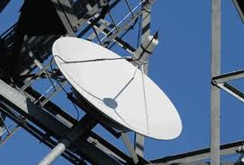
The meaning of a Public Goods
Public Goods are a product that one individual can consume without reducing its availability to another individual and from which no one is excluded.
Economists refer to public goods as "non-rivalrous" and "non-excludable".
National defence, sewer systems, public parks and basic television and radio broadcasts could all be considered public goods.

Slide 3
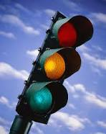
Non-excludable and non-rival
They are non-excludable and non-rival in consumption. An example is a street sign.
It will not wear out, even if large numbers of people are looking at it; and it would be extremely difficult, costly and highly inefficient to limit its use to only one or a few persons and try to prevent others from looking at it, too.
A traffic light or clean air is a further example.

Slide 4
Is it different from Private goods?
This question can best be answered by looking at the counterpart, a private good.
Private goods are typically traded in markets.
Buyers and sellers meet through the price mechanism.
If they agree on a price, the ownership or use of the good (or service) can be transferred.
Thus private goods tend to be excludable.
They have clearly identified owners; and they tend to be rival.
For example, others cannot enjoy a piece of cake, once consumed.

Slide 5
Public bads
This poses immediately the question of who, then, provides public goods.
Once they exist, they are there for all to enjoy.
So it is often the most rational strategy for private actors to let others go first and seek to enjoy the good without contributing to its production.
This is a dilemma, that public goods face. Without some sort of collective-action mechanism, they risk being under-provided.
Conversely, without collective action, public bads - such as pollution, noise, street crime, risky bank lending, and so on - would be over-provided.

Slide 6
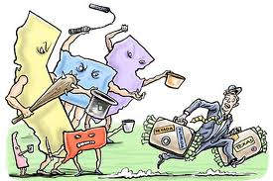
Public Goods and the Free Rider
Problem
Consumers have an incentive to not reveal their willingness and ability to pay for public goods .
After all, if the public good is supplied, it will be available to them just as it would be to anyone else because pure public goods are non-excludable.
This is the essence of the “free rider problem”.
Good examples to use include TV licence dodgers and people who choose to evade the Council Tax but who still receive local authority services.
Another example might be a group of residents in a block of flats who all stand to benefit from better lighting and security systems, but who individually might try to avoid payment and benefit once the improved amenities are in place.
Given the nature of the free rider problem, public goods are often financed through some form of enforcement, notably the compulsory nature of the TV licence fee, management fees for residents living in blocks of accommodation or the signing of international treaties on the environment.

Slide 7
Public Goods and Tax
Taxing those activities which has negative externalities.
Adjusting free riders through a proper regulation of tax.
Research on green taxation suggest that during the 1990s there was significant correlation between a country's UN Human Development Index (HDI) rank per fixed amount of GDP, and its level of green tax as a percentage of total tax revenues.
Furthermore, over periods longer than 5 years, data suggest that countries having higher green tax rates such as Norway, Sweden and Netherlands experience higher GDP growth and higher HDI growth rate.
However, these studies only show a correlation between green tax rates and higher GDP/HDI growth, not a causal effect.

